Slide 1
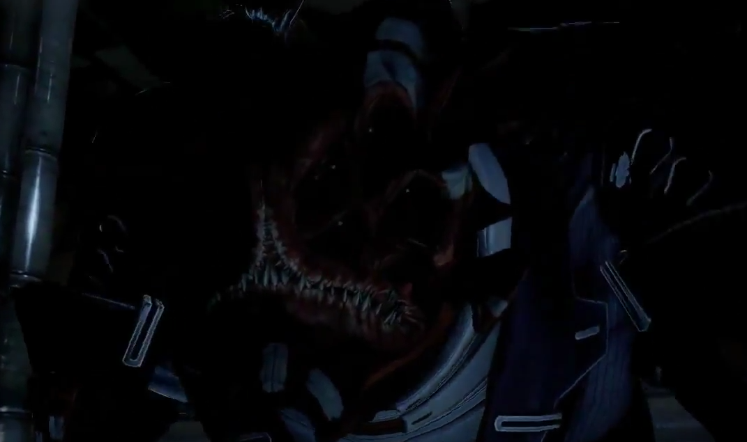
“I know your every secret, while you fumble in the dark”
A look at TheShadowBrokers and their Python exploits
Kade Morton
Mozilla Regional Coordinator
kademorton@protonmail.com / @cypath

Slide 2

If Aaron Swartz is your jam

Slide 3




Cyber warfare, it’s a thing
Sooooo much cyber...

Slide 4

Those damn Russians...

Slide 5


Know your Advanced Persistent Threats
Apparently, no one bothered to make a graphic for Cozy Bear

Slide 6
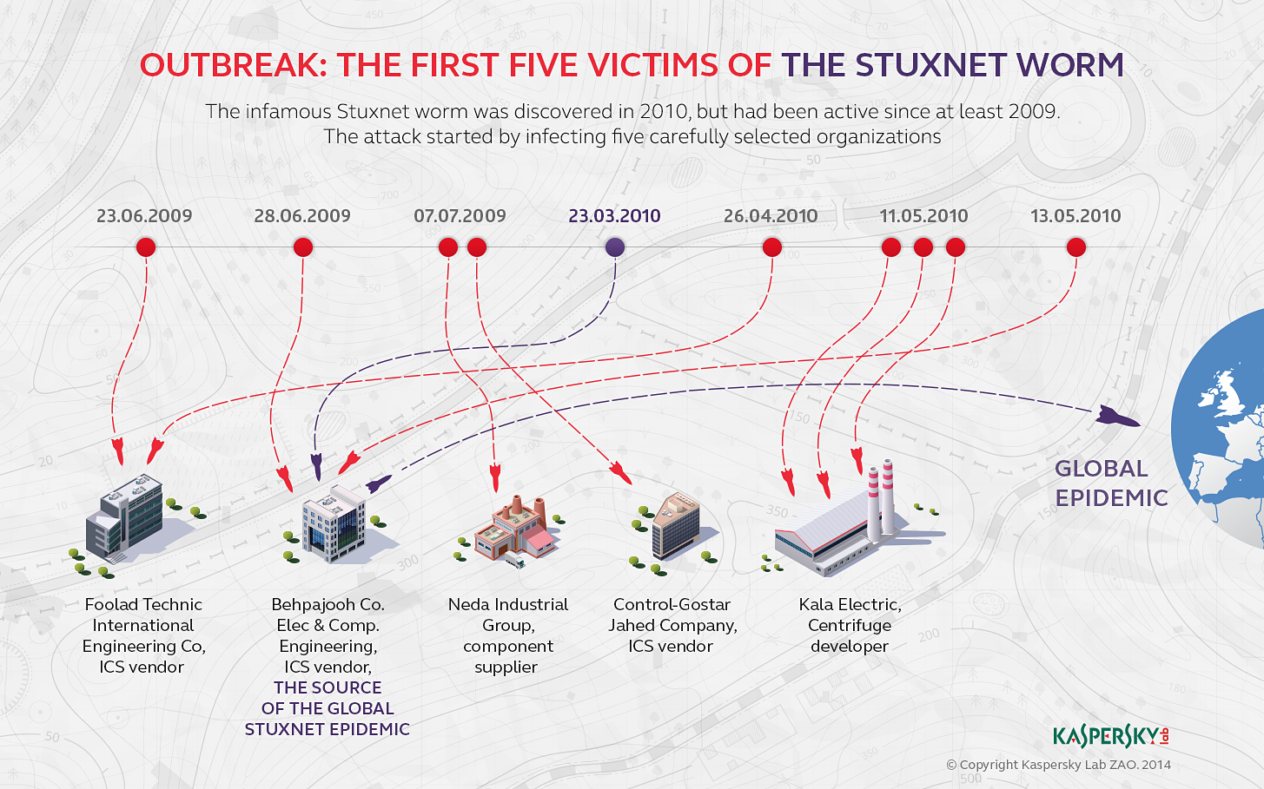

Slide 7
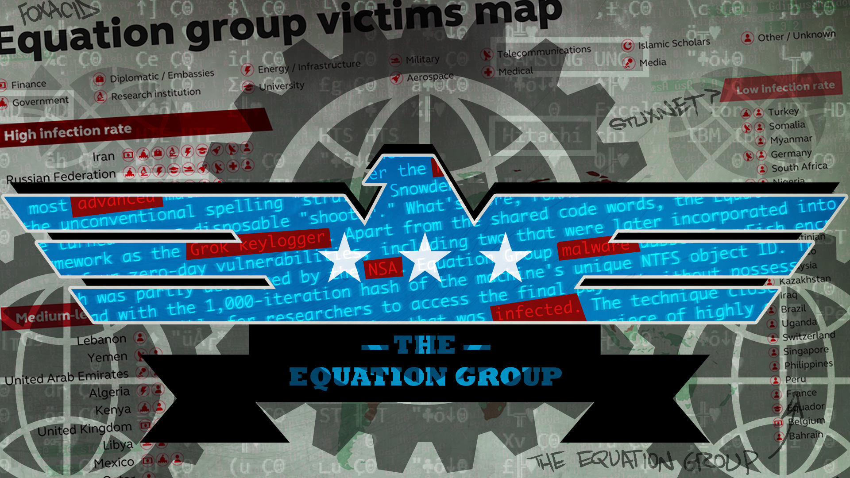
Yes, the US has silly named hacker groups too

Slide 8
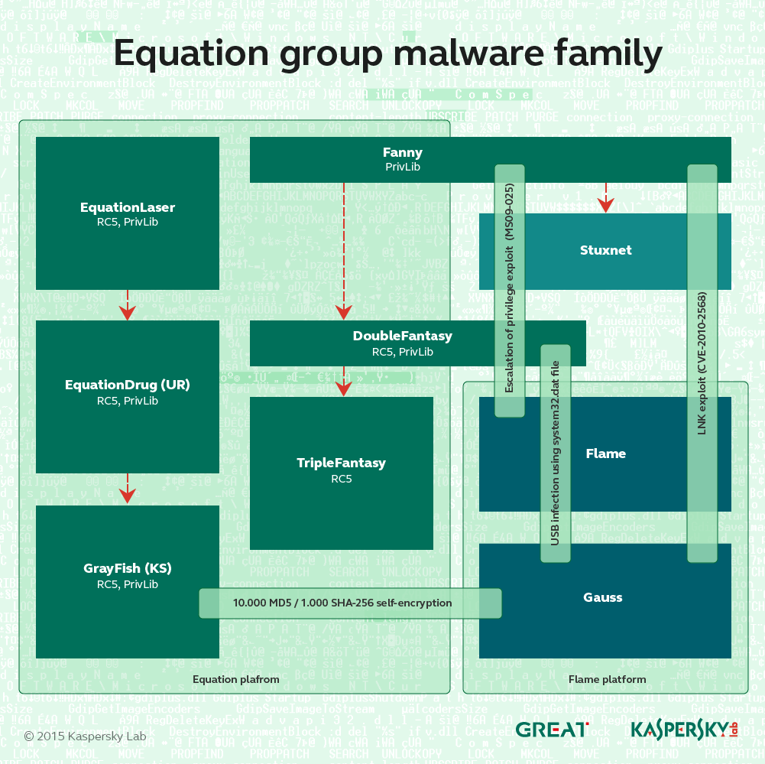
Ars Technica if you want to know more

Slide 9
https://arstechnica.com/security/2015/02/how-omnipotent-hackers-tied-to-the-nsa-hid-for-14-years-and-were-found-at-last/

Slide 10
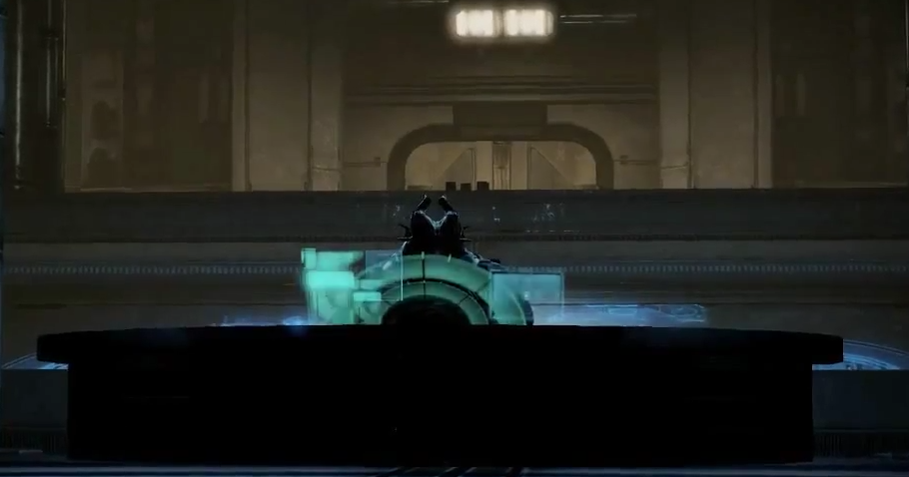
Enter TheShadowBrokers
There is a character in the game Mass Effect called the Shadow Broker, pictured here, which is where we believe this group took the name from

Slide 11

Oh, look over there, an abandoned NSA server

Slide 12

This all sounds a bit...

Slide 13

But turns out…

Slide 14
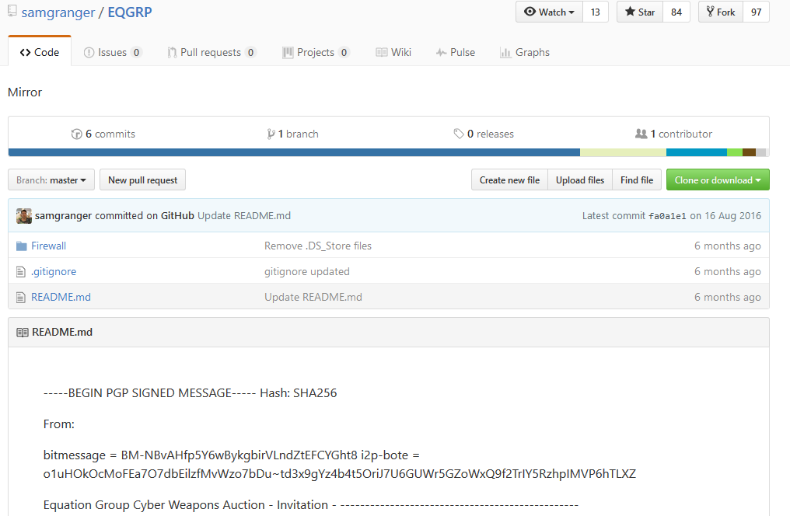
First dump is still up on GitHub
https://github.com/samgranger/EQGRP

Slide 15
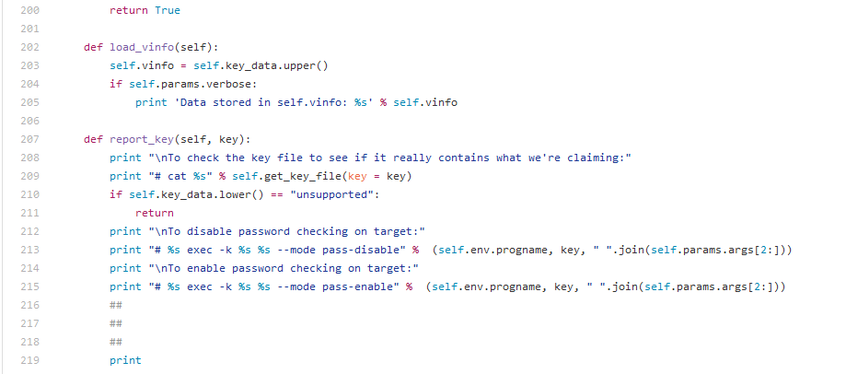
Are you sure this came with extra bacon?

Slide 16
http://xorcat.net/2016/08/16/equationgroup-tool-leak-extrabacon-demo/

Slide 17
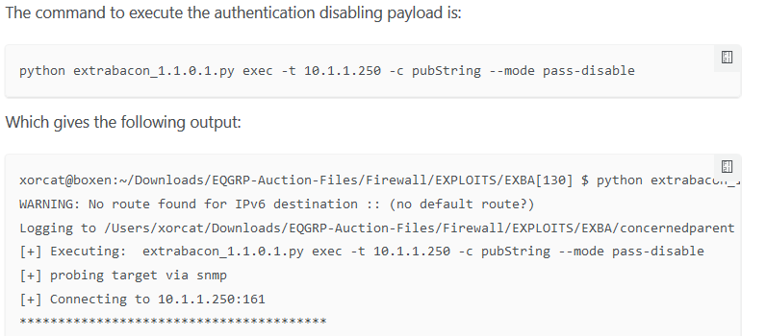
Command and output
The full output is much longer, go check it out

Slide 18
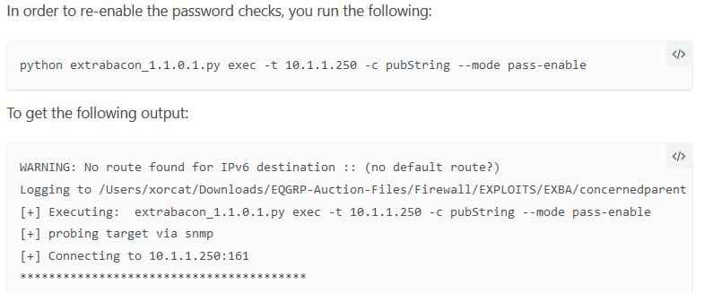
Stealth mode engage

Slide 19
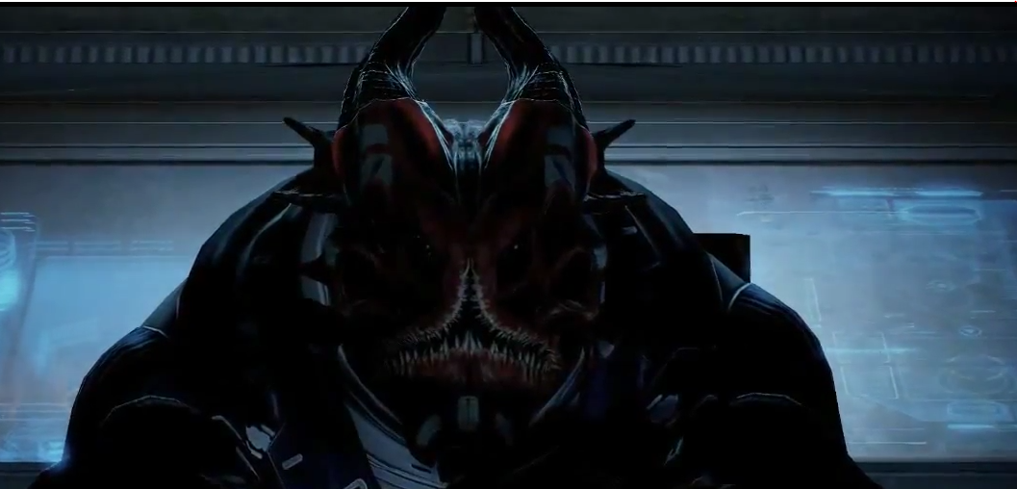
Some shadowy criminal genius has been arrested

Slide 20

Wait, what? This guy?!

Slide 21
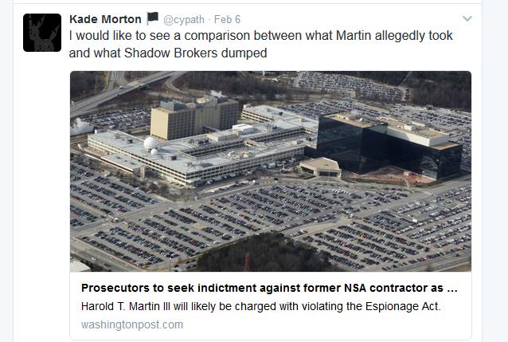
Let’s see some proof

Slide 22
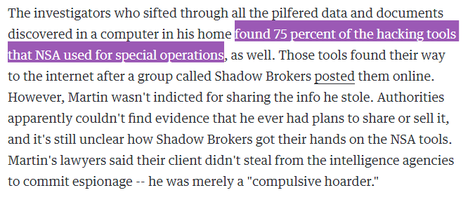
OK, yeah, there’s some proof...
https://www.engadget.com/2017/02/09/court-indicts-nsa-contractor/

Slide 23
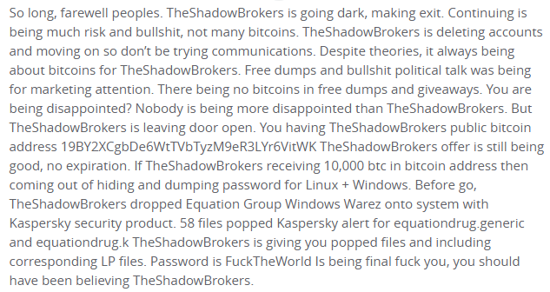
Goodbye

Slide 24
Any questions you don’t want to ask in front of the group
kademorton@protonmail.com
@cypath

